Slide 1

Data Analytics Portfolio
Project case studies
By Brian Avila

Slide 2

Table of Contents
Skillsets
Case Study 1: Influenza Medical Staffing Plan
Case Study 2: Rockbuster Stealth LLC Sales Data Analysis
Case Study 3: Pig E Bank’s Client Exit Analysis
Case Study 4: Instacart Grocery
Basket Analysis
Case Study 5: Main Contributors to Happiness
Project Links
Contact info

Slide 3

Skillsets
My Skillsets
Data Analysis
Tableau Visualizations
SQL Relational Databases
PostgreSQL
Python
MS Excel (Pivot Tables, VLOOKUP)
Time Series Analysis and
Forecasting
Statistical Analysis
Data Transformation and integration

Slide 4

Influenza medical staffing plan
Let’s Dive In
GOAL: To help a medical staffing agency that provides temporary workers to clinics and hospitals on an as-needed basis. The analysis will help plan for influenza season, a time when additional staff are in high demand. The final results will examine trends in influenza and how they can be used to proactively plan for staffing needs across the country.

Slide 5


Analysis
Data Sets
Tools
Process
Listed the data questions to be answered.
Designed a Data Research Project
Formulated a research hypothesis
Sourced the Right Data
Created a data profile
Implemented data quality measures
Integrated data from 2 sources into 1.
Conducted Statistical Analysis by calculating variance and standard deviation
Formulated a statistical hypothesis
Created an interim report
Influenza deaths by geography, time, age, and gender
Source: CDC
Download Data Set
2. Population data by geography
Source: US Census Bureau
Download Data Set
Microsoft Excel

Slide 6
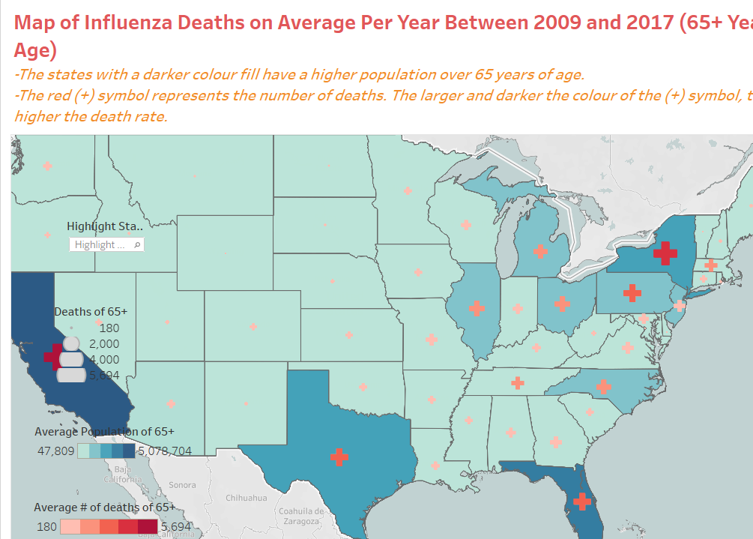
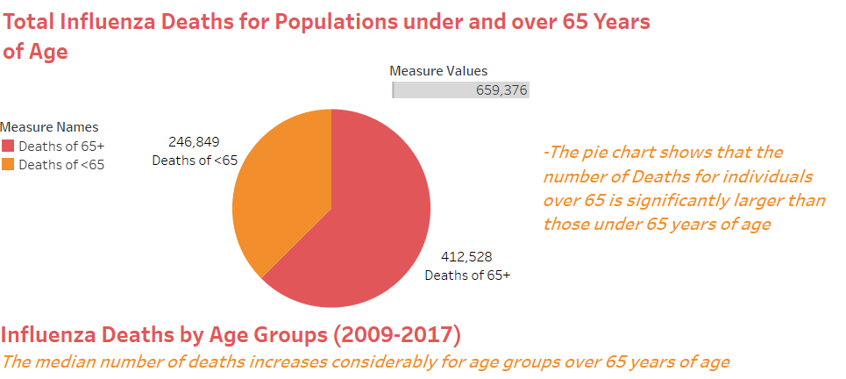
Visualizations & Storytelling

Slide 7
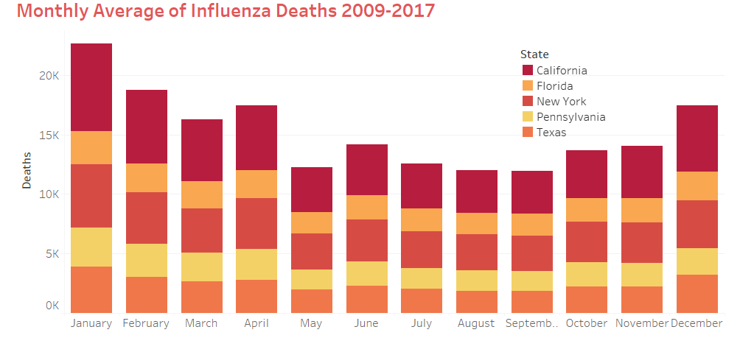
Conclusion
The analysis conducted revealed that Influenza poses a threat to populations over 65 years of age.
The states more populous with this vulnerable age group are California, New York, Texas, Pennsylvania, and Florida.
The months the Influenza Virus is more prominent are December, January, February, March, and April.
The states of California, New York, Texas, Florida, and Pennsylvania have historically high mortality due to Influenza.
It was recommended that medical staff should be sent to these hotspots during the peak months of December through April.
Project link

Slide 8

Rockbuster Stealth Sales analysis
Let’s Explore
Goal: The Rockbuster Stealth Management Board has asked a series of business questions and they expect data-driven answers that they can use for their 2020 company strategy.
Which movies contributed the most/least to revenue gain?
What was the average rental duration for all videos?
Which countries are Rockbuster customers based in?
Where are customers with a high lifetime value based?
Do sales figures vary between geographic regions?

Slide 9

Analysis
Data Sets
Tools
Process
Set up a database environment using the PostgreSQL
Created a data dictionary
Wrote SQL commands in PostgreSQL to answer business questions and organize and sort data
Filtered and ordered data using the WHERE and HAVING clauses
Created a data profile of summary statistics using SQL
Wrote subqueries to answer complex business questions
Rewrote subqueries as Common Table Expressions
Created a presentation of findings
Rockbuster Data Set
Download Data Set
Microsoft Excel

Slide 10
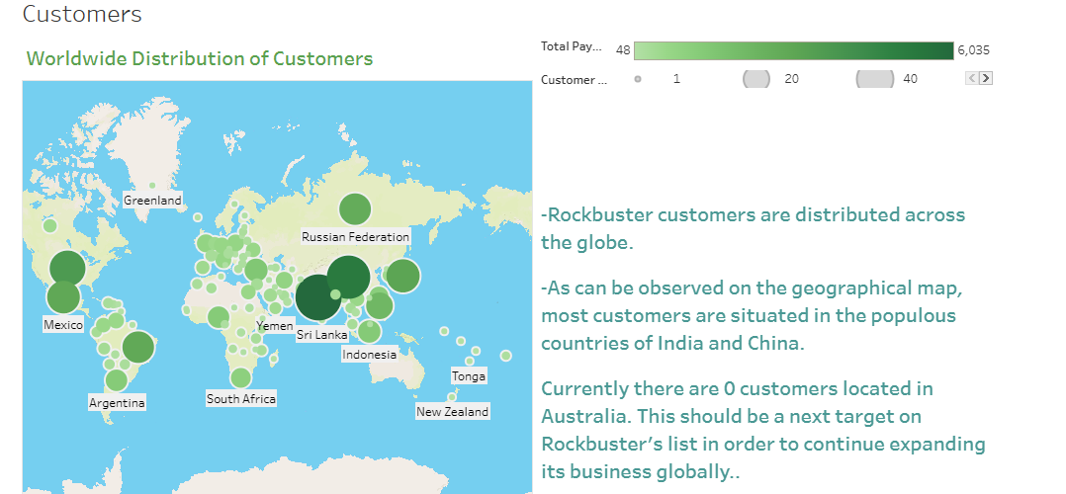
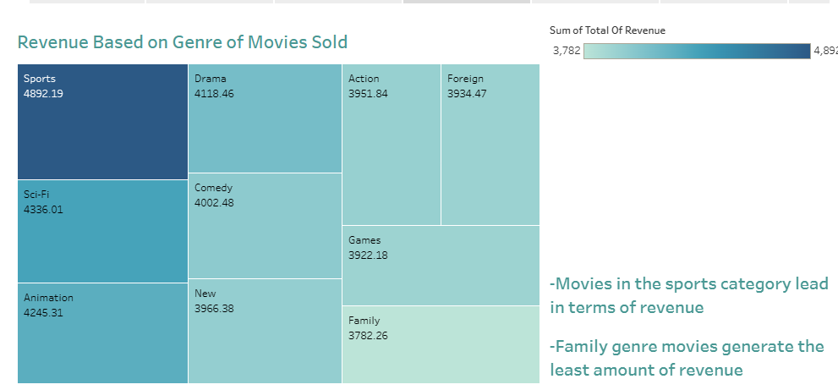
Visualizations of SQL results

Slide 11
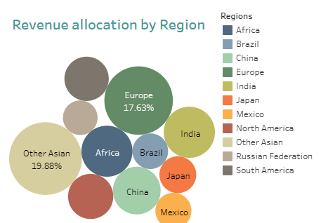
Conclusion
India and China combined contribute to 1/5th of the total revenue generated from all sales.
The Asian market makes up to 40% of all revenue and establishes itself as the principal source of revenue from all Rockbuster sales. Continuation of marketing efforts can still potentially increase the sales numbers in the region.
Also, expansion of marketing campaigns into countries where there are no registered customers, such as Australia, can generate more sources of revenue.
Project Link

Slide 12

Pig E BAnk
LOOKING AHEAD
Goal: To increase customer retention, the sales team wants to identify the leading indicators that a customer will leave the bank

Slide 13

Analysis
Process
Data Sets
Tools
Researched Software tools for handling big data
Suggested ways of controlling for bias and communicating concerns to stakeholders
Carried out steps in the data mining process, including data cleaning and descriptive statistics
Created a decision tree model to test the outcomes of an analysis
Analyzed the output of a linear regression and Identified the correct predictive model for different scenarios
Created a time series and a simple moving average in Excel
Created a GitHub account and repositories
Pig E Bank Clients Data
Download Data Set
Microsoft Excel

Slide 14
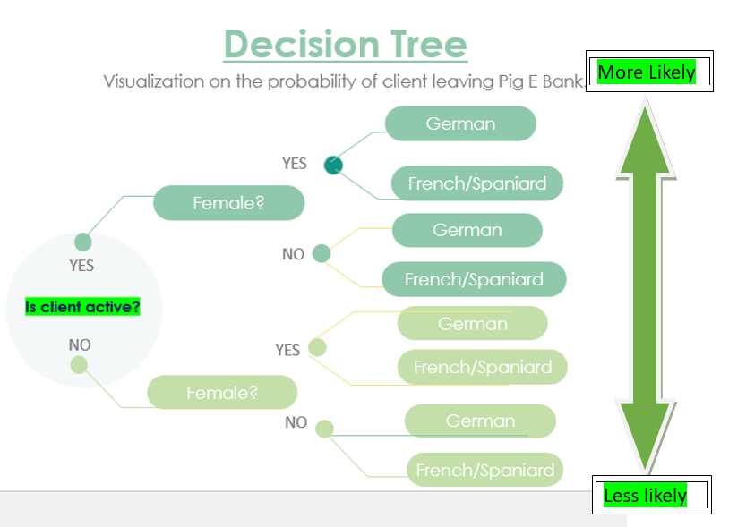
Visualizations

Slide 15
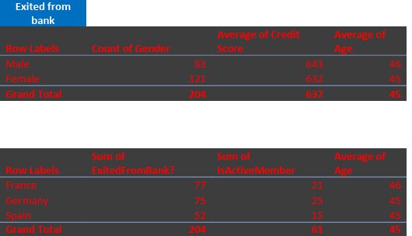
Conclusion
Based on the analysis of the data the determining factors for client loss are:
Inactivity (inactive clients are more likely to leave Pig E Bank)
Gender (Female client loss is disproportionate to males)
Nationality, (75 out of 178 German clients left the bank, highest percentage).
Project Link

Slide 16
Instacart Grocery Basket Analysis
Let’s Take a look
GOAL: To obtain informational knowledge about who the customers are and their purchasing behaviors. To build an effective marketing strategy we need to analyze customers spending habits.
The sales team needs to know what the busiest days of the week and hours of the day are to schedule ads at times when there are fewer orders.
They also want to know whether there are particular times of the day when people spend the most money, as this might inform the type of products they advertise at these times.
Marketing and sales want to use simpler price range groupings to help direct their efforts.
Are there certain types of products that are more popular than others?

Slide 17

Analysis
Process
Data Sets
Tools
Downloaded data and imported into notebook as a panda's data frame
Conducted basic descriptive exploratory tasks
Data Wrangling
Checked Data for Consistency
Analyzed results from merge flag frequencies
Exported merged data as a pickle
Grouped and Aggregated Data
Summarized analysis findings
Created a report describing analysis results, and recommendations for Instacart stakeholders
Instacart Market Data
Download Data Sets
Microsoft Excel

Slide 18
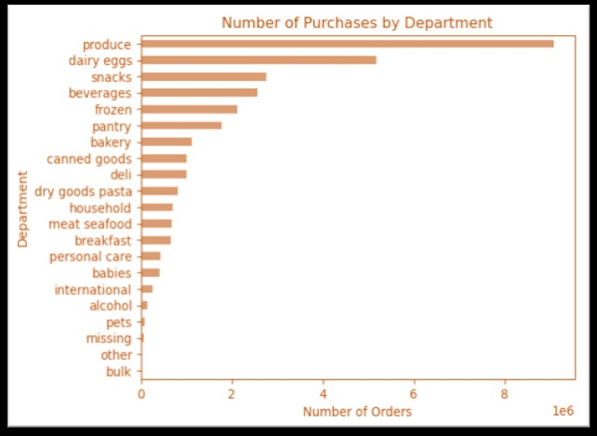
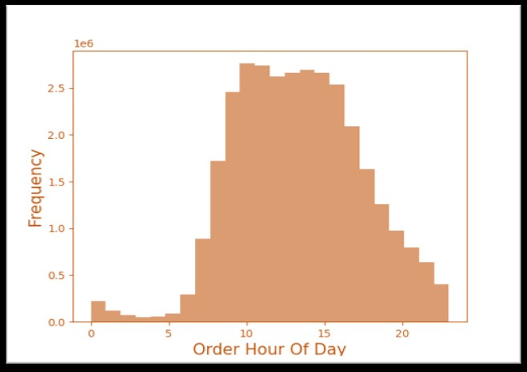
Visualizations
The produce department receives the most orders followed by dairy then snacks.
According to the chart above we can observe that most purchases occur between 9am and 4pm

Slide 19
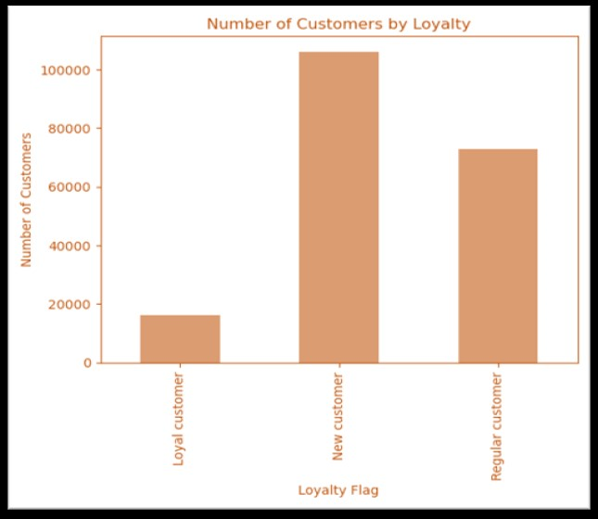
Conclusion
Most orders occur from 9 AM to 4 PM and on weekends. The sales team can schedule ads during off-peak hours to make the most impact when orders are fewer.
Most products are priced between $2 and $15. This highlights a strong preference among customers for affordable and moderately priced items
Focusing promotional efforts on high-demand departments like Produce, Dairy & Eggs, and Snacks products will enable us to create effective marketing campaigns that align with customer needs.
We suggest initiatives to attract new customers, enticing them with appealing offers to make their initial purchases and introduce them to the benefits of loyalty programs.
Project Link

Slide 20
Main factors contributing to happiness
Let’s Dig deeper
GOAL: To obtain informational knowledge about who the customers are and their purchasing behaviors. To build an effective marketing strategy we need to analyze customers spending habits.
The sales team needs to know what the busiest days of the week and hours of the day are to schedule ads at times when there are fewer orders.
They also want to know whether there are particular times of the day when people spend the most money, as this might inform the type of products they advertise at these times.
Marketing and sales want to use simpler price range groupings to help direct their efforts.
Are there certain types of products that are more popular than others?

Slide 21
Analysis
Tools
Process
Data Sets
Microsoft Excel
Sourced the data
Conducted exploratory visual analysis using relevant Python libraries.
Wrangled and cleaned the data. Checked Data for Consistency
Conducted a geospatial analysis by creating a choropleth map using relevant Python libraries
Ran a linear regression on the data and analyzed the model performance statistics.
Performed a cluster analysis
Created Data Dashboards on Tableau based on the results of the analysis.
World Happiness Report
Download Data Sets

Slide 22
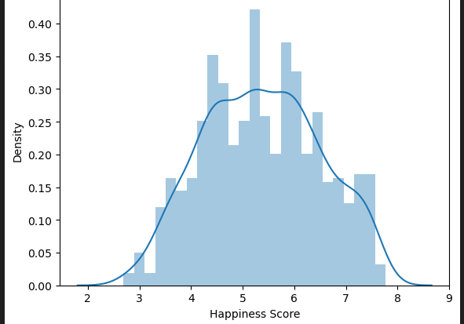
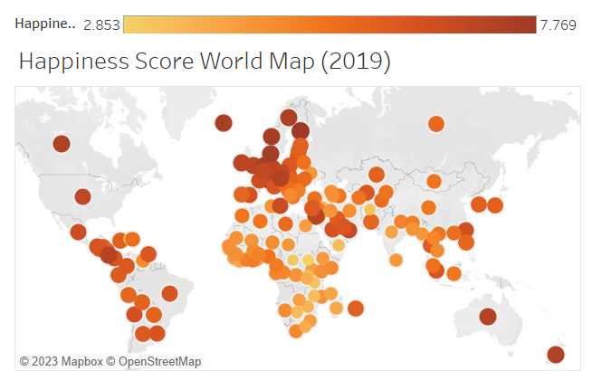
Visualizations
Chart shows the distribution of global happiness scores between 2015 and 2019. The mean happiness score is 5.4.
The world map above visualizes how the happiness scores are distributed globally in terms of high and low.

Slide 23
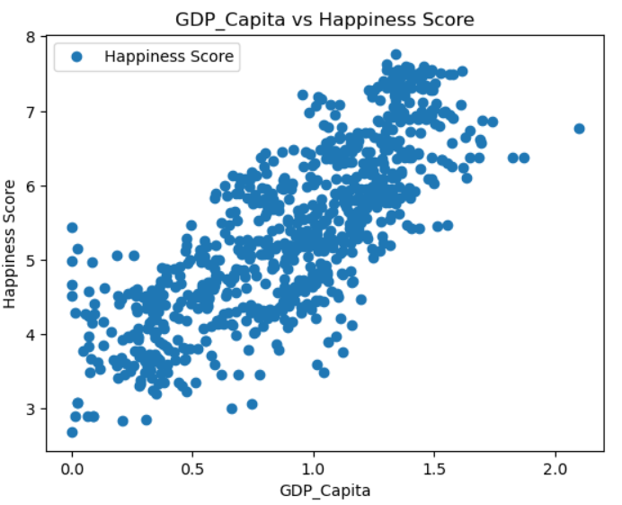
Conclusion
Based on the analysis of the World Happiness Report we can answer our pre analysis questions:
The top 5 ranked countries with the highest happiness scores are: Denmark, Finland,
Iceland. Norway, and Switzerland.
The top 5 unhappiest countries are: Burundi, Central African Republic, Rwanda, South Sudan and Syria
The analysis validated the hypothesis that "Countries with a high level of freedom are likely to have a correspondingly elevated happiness score" by revealing a connection between freedom and happiness score, supported by regression analysis.
In summary, our analysis unveiled strong positive correlations between GDP per capita, Family, and Life Expectancy with happiness scores. Freedom and Generosity also correlated positively, while corruption showed a slightly negative correlation
Following our results, we determined that the main factor from the report contributing to the happiness level of the population of a country is its GDP per capita or economy.
Project Link

Slide 24



THANK YOU
Project links
CONTACT INFORMATION
(25) Brian Avila | LinkedIn
+1 (508) 905 9144
brianavila819@gmail.com

